Slide 1
Open Sourcing From Within Your Company, For Your Company
POSSCON, Wednesday, March 28th 2012
by Bob Williams
Notes:
Thank you for having me
I’m really glad and honored to be here
What a great event this is…how about a quick round of applause once again for posscon ☺

Slide 2
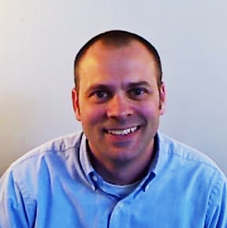
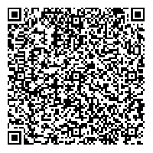
About Me
Bob Williams
CTO / Analytics Evangelist
bob.williams@sparcedge.com
Twitter
@_bobwilliams
Come see Innovation, Culture
and Open Source in Action
tours@sparcedge.com - tours held daily.
www.sparcedge.com
Notes:
I am responsible for leadership, technology vision and direction
I am very active on Twitter. You can find me @_bobwilliams
And I am very passionate about
open communication,
innovation through collaboration and
free exchange of ideas
Which is great because

Slide 3
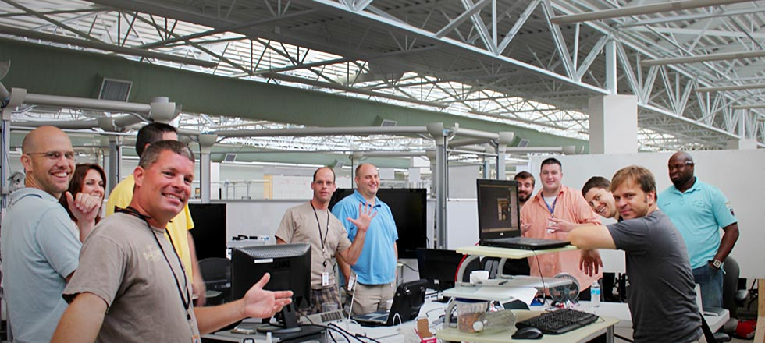
Welcome to SPARC!
Software Development
2011 Best Place to Work in SC
150+ employees / 498% Growth in 2011
Notes:
The company I work for fully embraces my passions
At SPARC we believe we engage people through better information
We have a really good work environment
Decent size shop and we’ve grown a lot
And oh yea…we write software ☺
Whether it be for Enterprise, Cloud, Web, Mobile, Cyber, Analytics, Culture, Engagement, Green Energy

Slide 4
Open Source Your Entire Organization
Open Source Everything!
Notes:
open source everything
Not just use open source software,
Open source departments, processes, projects
give away your intellectual property and company secrets
So, who believes they could open source their entire company?
Who believes their entire company would expose or give transparency into what you would typically consider intellectual property and company secrets.
Anyone? Show of hands? ☺
Change in perspective – seems to have a tremendous amount of risk.
easier than you think
we are doing it at SPARC. We are open sourcing our company more and more everyday.
Now, I know open sourcing your entire company that might seem to be a bit too much at the moment
However if you do,
Excited, engaged and innovative workforce
Better understanding business and processes
Competitors become collaborators
Practically all for free
You may be thinking that I do not even know where to start.
So let me show you what you can do to get there.
The steps to take

Slide 5




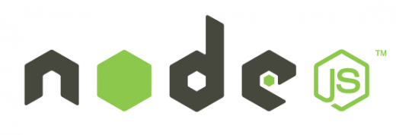





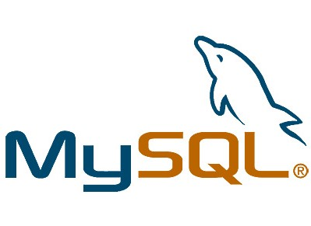


Step One – Use
Find open source software that you can use in your projects.
Get used to it and the open source model.
Take that first step to using it!
Notes:
So, step one is to use open source
Allow it, get used it, learn about it
Find projects you have today that can leverage open source software
Maybe that’s a lower risk project to use as your comfort builds
Maybe that’s an internal or R&D effort
But bring open source software inside your walls so you can understand the model and take that first step.
We use open source

Slide 6
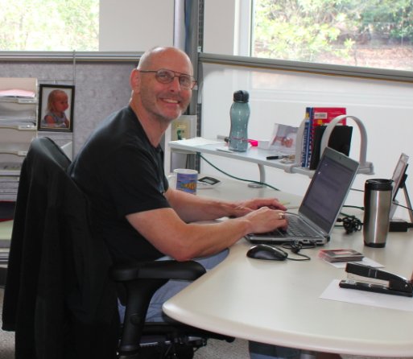
Step Two – Contribute
Give back to the community and uphold your end of the open source agreement.
Learn the “share/make it better” part of open source.
Take that next step!
Notes:
contribute back to the projects you are using
often overlooked piece
Community
Learn the benefits by seeing them work for someone else
Share/make it better
Dev download open source and not contribute
Take that next step!

Slide 7
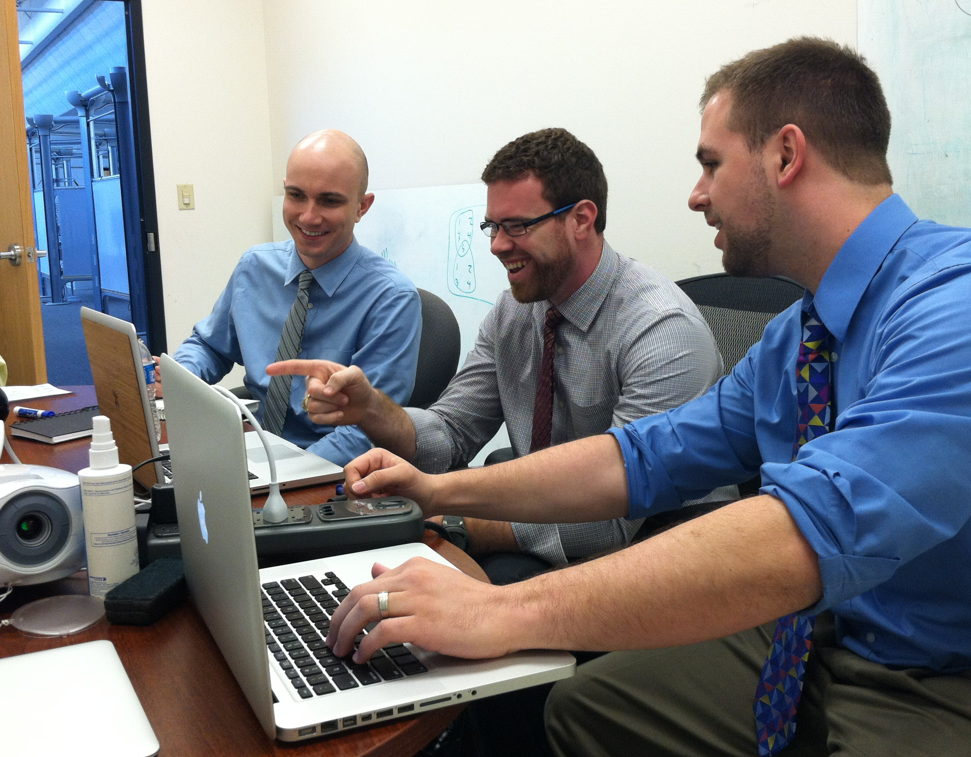
Step Three – In-House
Learn how to open source your own project(s).
Allow them to work together across teams and build better collaboration.
Create excitement and additional energy!
Notes:
in-house open source solution.
Open source your own project from the ground up
Use github, bitbucket or similar
Create the support for your engineers to contribute to each others projects
Set boundaries

Slide 8
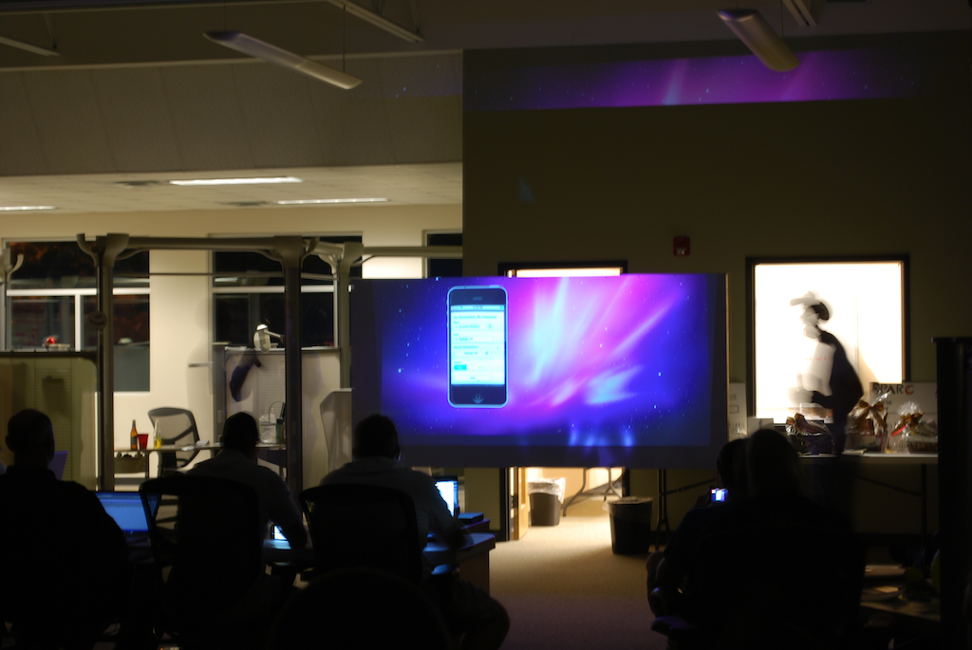
Step Four – Review
Developers like clout and like to be heard.
Let them show-off to their peers, managers and the company as a whole.
Give them bragging rights!
Notes:
I’m speaking to the IT leaders, managers, executives
Peers, leadership, executives, company
clout and bragging rights
Waterfall vs agile

Slide 9
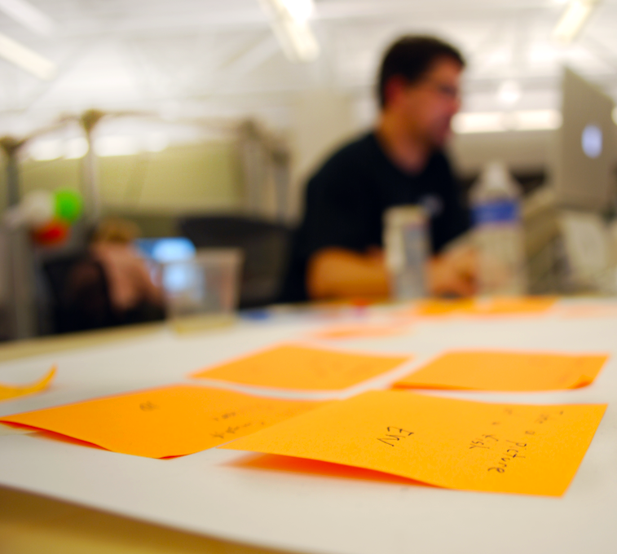
Step Five – Expand
Now that you have embraced open source, don’t stop.
In what other areas of your company could you apply the open source model?
Find ways to capitalize on the advantages of the open source model throughout your entire organization!
Notes:
Might seem the hardest but it’s the easiest step
You now understand open source
Have learned a lot
Don’t stop now
Take it to that next level

Slide 10
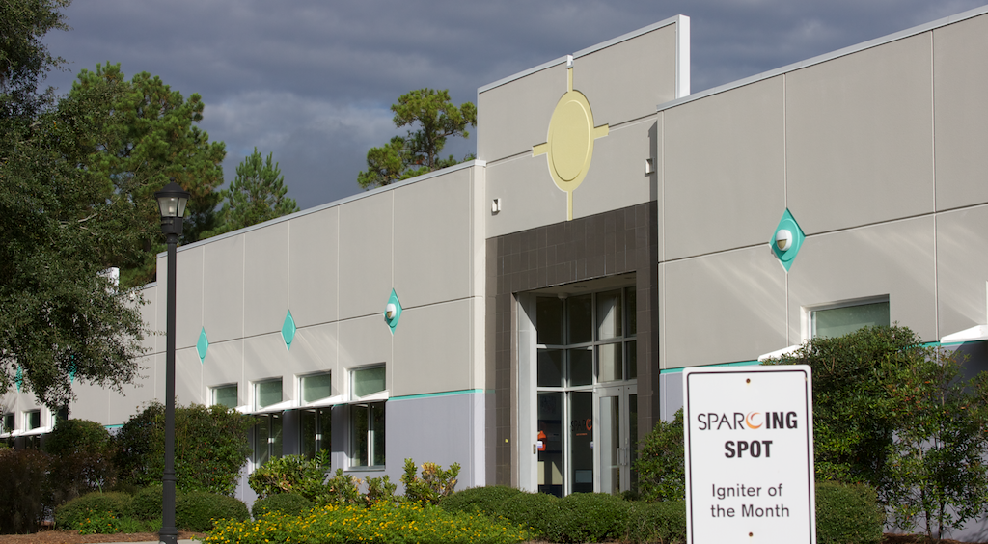
SPARC Open Sources
Notes:
SPARC we open source more and more everyday
We are embracing the model more fully and learning from it
Too often we hold onto this “thing” we’ve created and put it in a box thinking we’re either keeping it’s value or making it more valuable
When in fact, that’s really not the case
If anything, sharing it and allowing others to make it better gives it increased value
Facebook & Datacenters - how to build them
Google – MapReduce community promise
Yahoo – hadoop
So, let me show you a few of the things that SPARC open sources

Slide 11
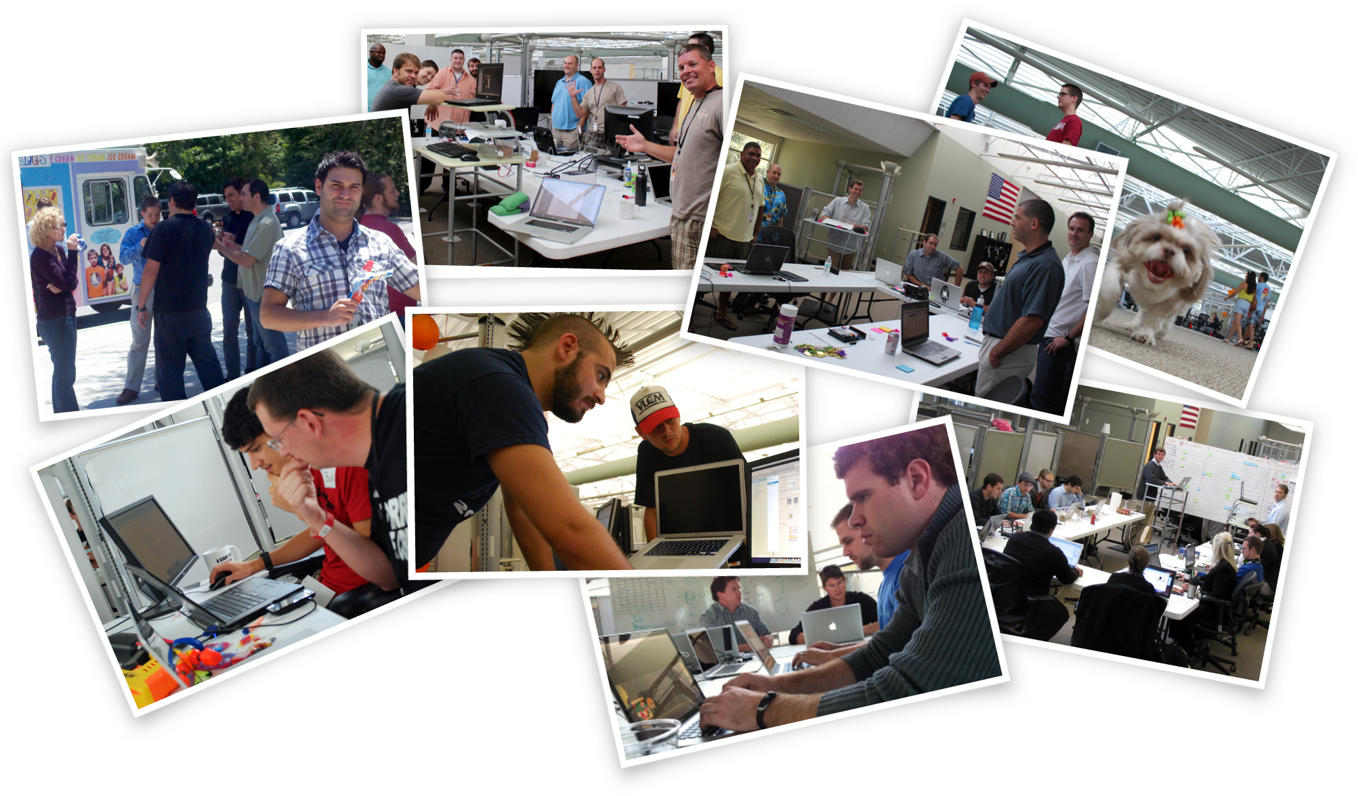
Tours
Notes:
We have transparency at every level here at SPARC that starts once you walk into the building
What you may see – dogs, nerf darts, beer, ping-pong, collaboration, whiteboard, backlogs, project progress, music, ppl on FB, meetings
Cop and his tour
So how is this open source?
We show you everything and
We solicit feedback

Slide 12

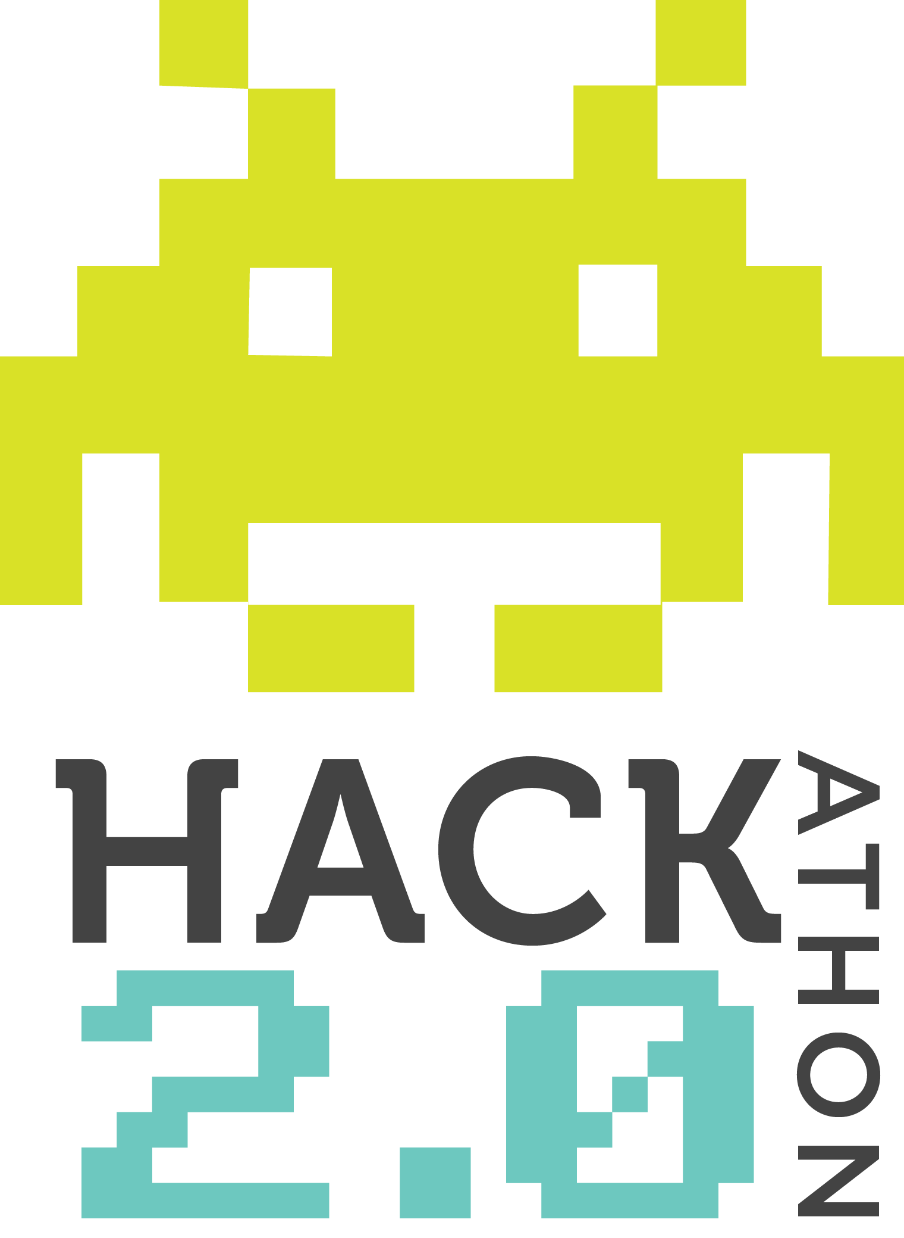
Hackathons
Notes:
Describe the event
Teams dressed up
Food & beverages
Caffeine and beer
Games
All ages
Tell how great the event was and what it was like
So how is this open source?
Open source the code back to the community
Volunteers to help us run it
Winnings donated back to charity

Slide 13
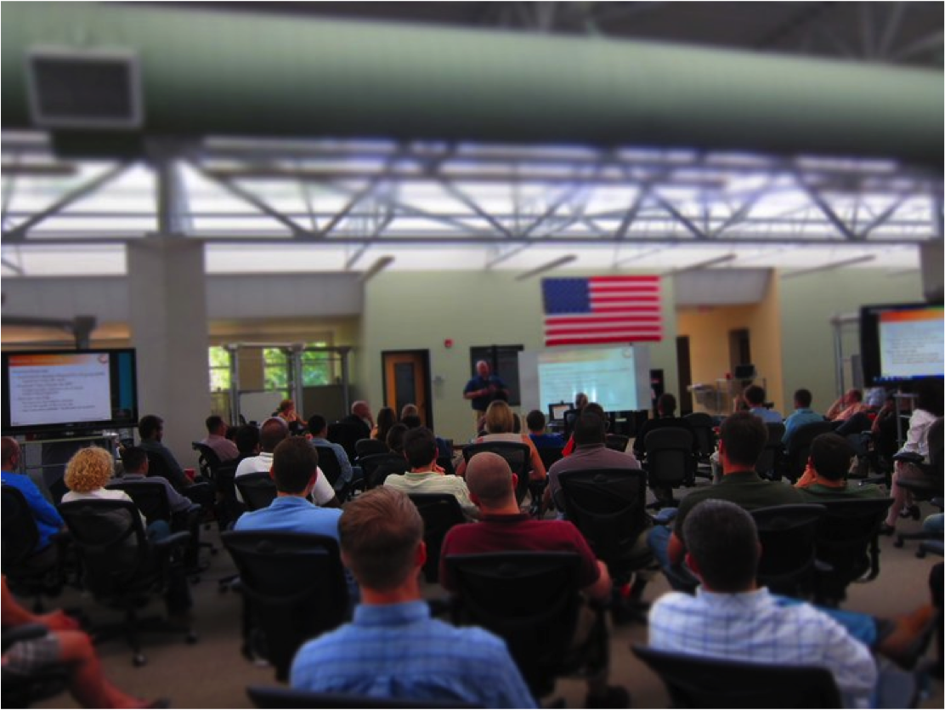
SPARC University
Notes:
Why do we have SPARC U
lunch-and-learns, Hosting user groups, multi-day long classes; android development for example, Certifications
We have even hosted GitHub, VMWare, Healthy Lifestyles, Employee Recognition the list goes on
Github and going for drinks afterward
InHouse open source software
So how is this open source?
open to the public
Team members generate content
Surveys and feedback on how to make it better

Slide 14

SPARC Ventures
Notes:
Who believes they have a good idea?
Anyone who has tried to start their own business knows it hard…it’s damn hard.
open source SPARC’s SDLC
Application stage and if it’s a good idea we move forward from alpha all the way to release to production
First round Q1 this year and by 6/1 SPARC will new product
One of the ventures is even being funded by someone outside of SPARC.
At the end the venture team gets to be mini CEOs basically.
From ownership to profits
Venture getting outside funding
So how is this open source?
SPARC open sources its entire SDLC
and the resources that go along with it

Slide 15
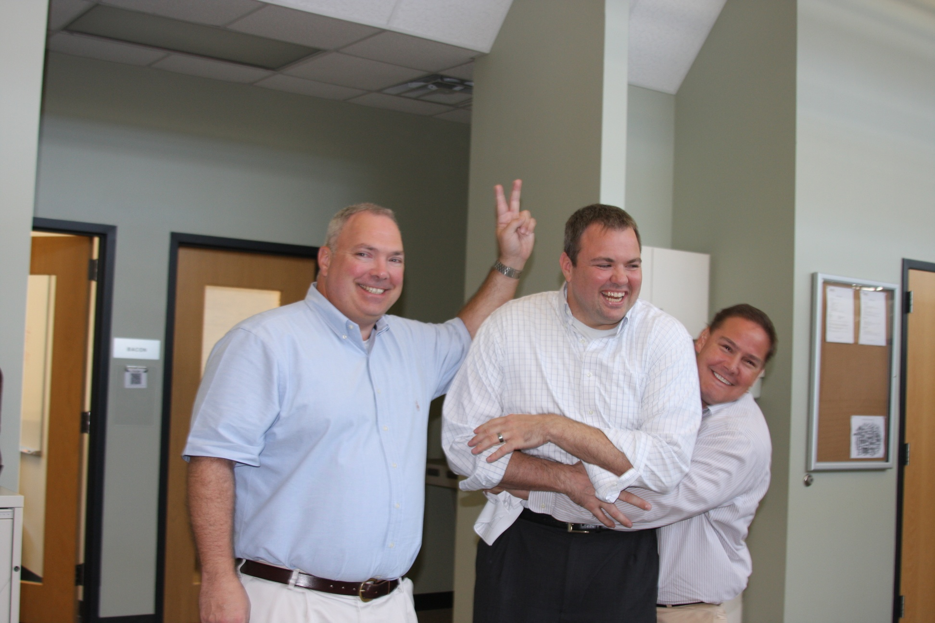
Human Resources
Notes:
We basically just give this stuff away ☺ we’ve given all the below away
Check-in Process is shared and feedback is gather
Team Members have the ability to contribute
Normal beer for example
Better chairs
Annual Review Process
Team Members have actually helped shape it
Other companies have made it better
Goal Setting
Many companies feed from the executive level down
We have the team members define goals for the company
Shared with other companies and contributed to by other companies
How is this open source?
All of our company contributes to our HR processes
All of our HR processes are shared and contributed to by others
Only making them stronger

Slide 16
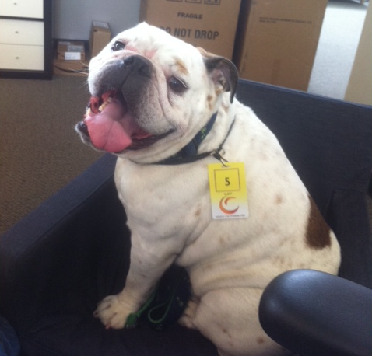
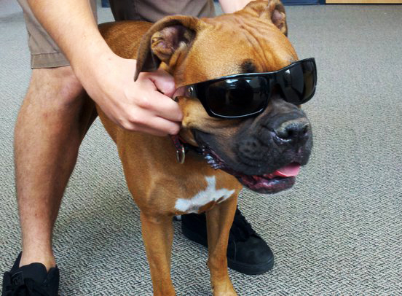
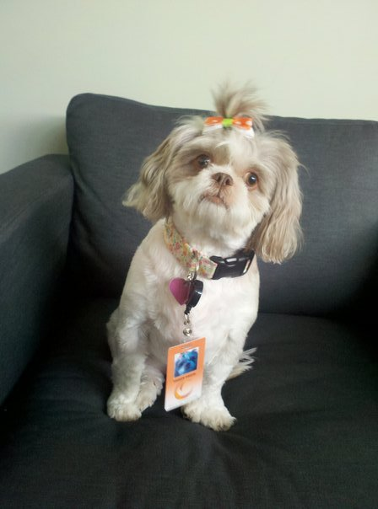
Recruiting
Notes:
Some of our newest hires ☺
Interview process
Anyone can sit in on an interview – engineer to CEO
see all the comments and feedback
shadow day – bait & switch
single veto policy
jobs for family and friends
Even candidates where there isn’t a fit
Story about asking candidates how tour went and what we could do to make the interview better
So how is this open source?
Everyone contributes
We always ask candidates how the interview went and for feedback

Slide 17
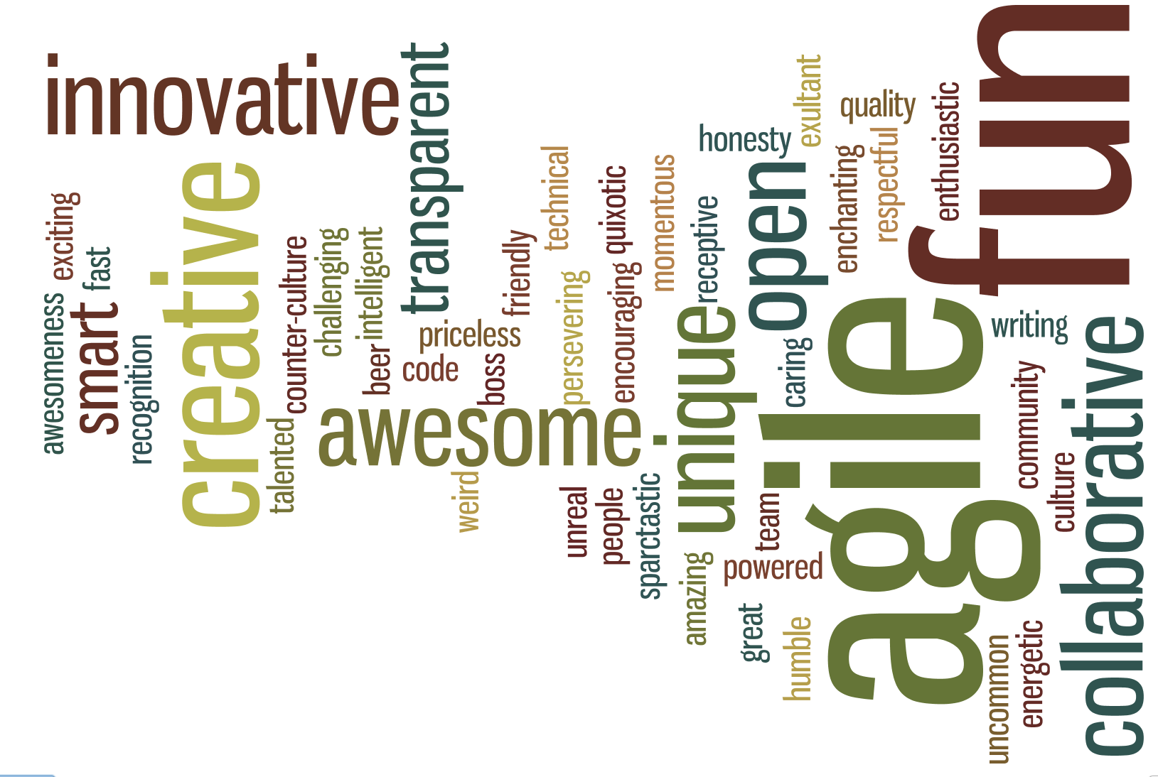
Culture
Notes:
A transparent, open culture always asking how we could have done better
A culture where whether your are a 1st day intern or the 1st employee hired you feel and know that you do not need permission to contribute.
Project Updates
SPARC Spontaneous
Sparc showcase
Project Brainstorming
Clients in the building and people
Table Time
So how is this open source?
Always looking to share what we have…always looking for others to contribute

Slide 18
Your Challenge!
Why don’t we
Open Source
Our Entire Company?
Notes:
Bold statement
Open Source Everything!
bold promises too
A more engaged and excited workforce with greater innovation
Of honing and maturing your business and process
Of having your competition become your collaborators
You I even have the steps to get you there.
You’ve seen what SPARC is doing so you have some ideas on what others are doing
So, my challenge to you as you leave today
Would be to ask yourself why don't we open source our company?
Why not take advantage of this model and as a result
have a more engaged and excited workforce
have people from outside as well as inside hone your business and make it run better, faster and stronger
Create stronger innovation, excitement and engery
And you can get all this for free

Slide 19
Oh, and by the way…
This Entire Presentation Has Been Open Sourced!
https://github.com/sparcedge/OpenSourceYourCompany
Notes:
Oh and btw…as I have said SPARC, is embraces the open source model
and in that spirit we have open sourced this entire presentation which you can find at the above link
It’s free to you to take and use as needed and improve as you want
I only ask that if you do please drop me a line and let me know…I’d love to hear from you

Slide 20
Thank You!
bob.williams@sparcedge.com
@_bobwilliams
tours@sparcedge.com
www.sparcedge.com
Notes:
Ok, I’ve taken up enough of your time and want to thank you for being a part of this
If you have questions I’ll be around, please come find me and we can chat
I’d also like to reiterate that if you are skeptical or not sure about all this
Or you just want to see it all in action please do stop by and let us give you a tour
I think you’d enjoy it and I know that we would love to have you stop by
Thank you!

